Slide 1
Research Lesson 3
Keywords & Evaluating
Websites
Caroline LaMagna
ITRT
Suffolk Public Schools

Slide 2
What is a Research Paper?
A research paper is like a report.
Before you write it, you use books, articles, the internet, and other sources to find information about your topic.
You gather information from these sources and use that information in your paper to tell your readers about your topic.

Slide 3
Choosing a Topic
Pick a topic
You may be given a topic by your teacher, have a list of approved topics to choose from, or you may have the option to choose a topoic on your own.
If you have a choice, try and choose something you’re interested in.
For example:
Thanksgiving

Slide 4
Narrow the Topic Down
“Thanksgiving” is a very broad topic. Try make your topic smaller and more specific by asking a question like:
Smaller Topic:
The first Thanksgiving

Slide 5
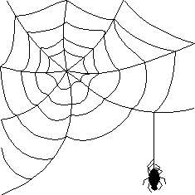
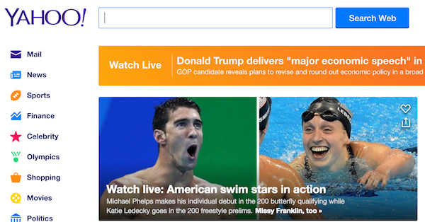
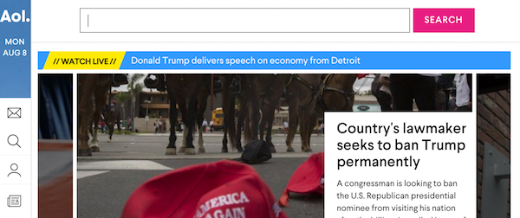
Search Engines
A search engine is a web-based program that is used
to locate information on the World Wide Web. Search engines create lists of documents for specified keywords .
Think about a Web search engines as a tool that sends out a spider to fetch as many documents as possible on the World Wide Web. Many website owners rely on search engines to send traffic/searchers to their website. Here is a few of the most popular search engines!

Slide 6
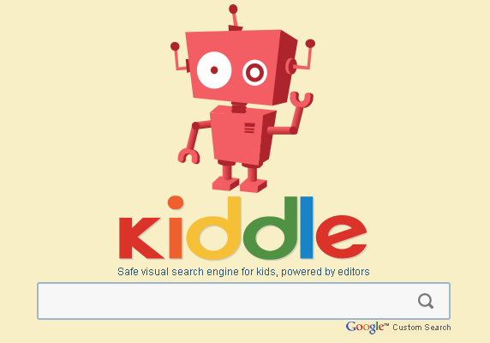
Search Engines for Kids
& Digital Safety
There are several search engines developed specifically for children. Some of them are shown below. They were designed exclusively for young people ages 6 to 12. They create a free, safe, fun environment for kids to easily research school topics. Unlike adult search engines—most have built in filters so it only shows information that is appropriate for children. However, the World Wide Web is a very big community and occasionally you might see something inappropriate or makes you feel uncomfortable. What should you do if this happens to you?

Slide 7
Keywords: the most important words related to a subject, which you type into a search engine to find the information you want.
Keywords need to be clear and precise. You can use synonyms and/or alternate words.
When searching, if you don’t find the results you are looking for, you may need to change your keywords!

Slide 8
Pull Out Your Keywords!
the first Thanksgiving?
Now type those keywords into a safe search engine and click on the magnifying glass!
first Thanksgiving

Slide 9
Let’s Begin Our Research
Now that we have narrowed our topic, decided on the question, and pulled out our keywords to search--- it is time to look for sources of information.
Let talk about how to evaluate web sites. Take a closer look at what a results page
might look like! We are on a hunt to
find good/reliable sources!

Slide 10
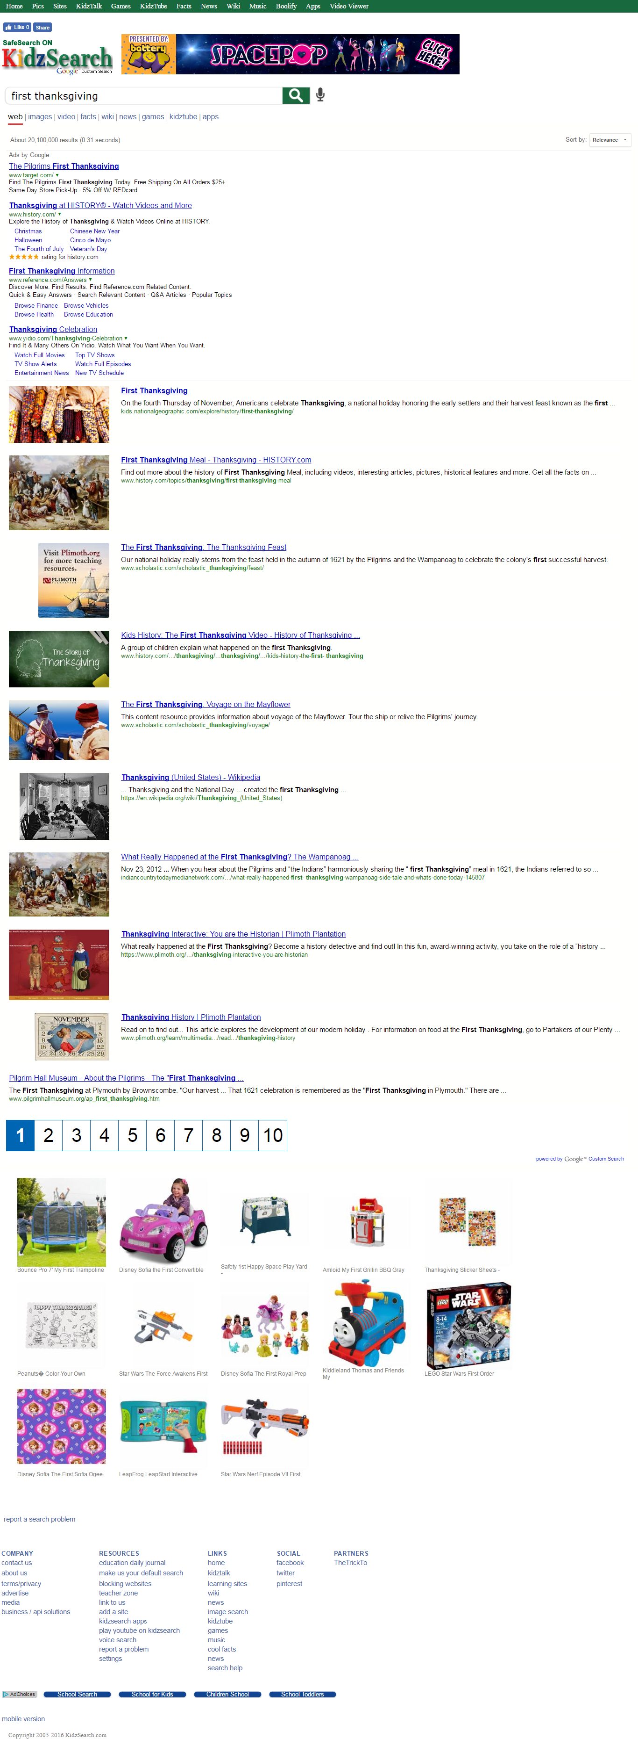
Advertisements
Web sites &
sources
that match
your search
Multiple
Results pages

Slide 11
Search bar
Number of
Results
(this search gave more than 20,100,000
Results!)
Ads by Google
Avoid clicking on any adds

Slide 12
Evaluate
The Results
Reliability
Since anyone can post anything to the web, you have to be careful about choosing your sources.
Best domain names:
Education websites (.edu)
Government websites (.gov)
Some Non-Profit websites(.org)
Teacher approved sites
Websites maintained by someone you know – like your teacher.

Slide 13
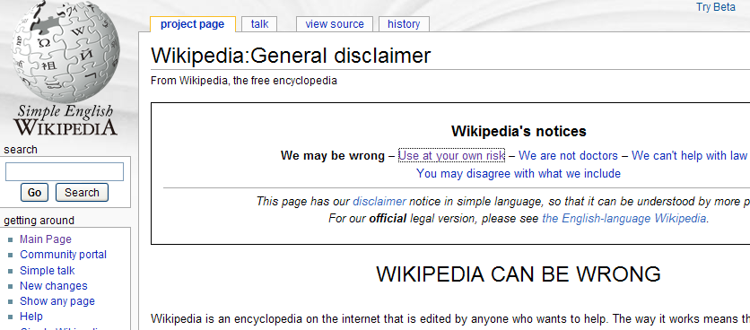
Wikipedia

Slide 14
Look at the first three sites that come up. Read the description and check the domain extension!
Title of the Article
Short description of the article
The websites URL address – look at the domain extension!

Slide 15
Using your best judgment, click on the first link you feel is reliable and evaluate the website.
Ask yourself these
questions:
Does it look reliable?
When was it published?
Who is the author?
Does it have the information you are looking for?
If not, arrow back and try the next source.

Slide 16
Taking Notes –
Recording your information
Once we find a reliable source--we want to read the article carefully to gather our information! We will learn how to properly take notes next week.
And after we record all the information from the site that you feel is important, we complete the final step………

Slide 17
Reminder: Making Your Citation –
Citing Your Sources
Keep track of all the sources from which you gather information.
After you write your paper, create a “Sources Cited” page or simply list all of the sources you used to gather your information at the bottom of your page.
Name Website
Date Published
Web
Date Accessed
The History Channel Website. 2016. Web. November 3, 2016
The Library of Congress Website. 2015. Web. November 3, 2016

